Slide 1
Visual Supplements
Deposition Rate Optimization
Charts, Diagrams, and Tables
for Technical Presentation Enhancement

Slide 2
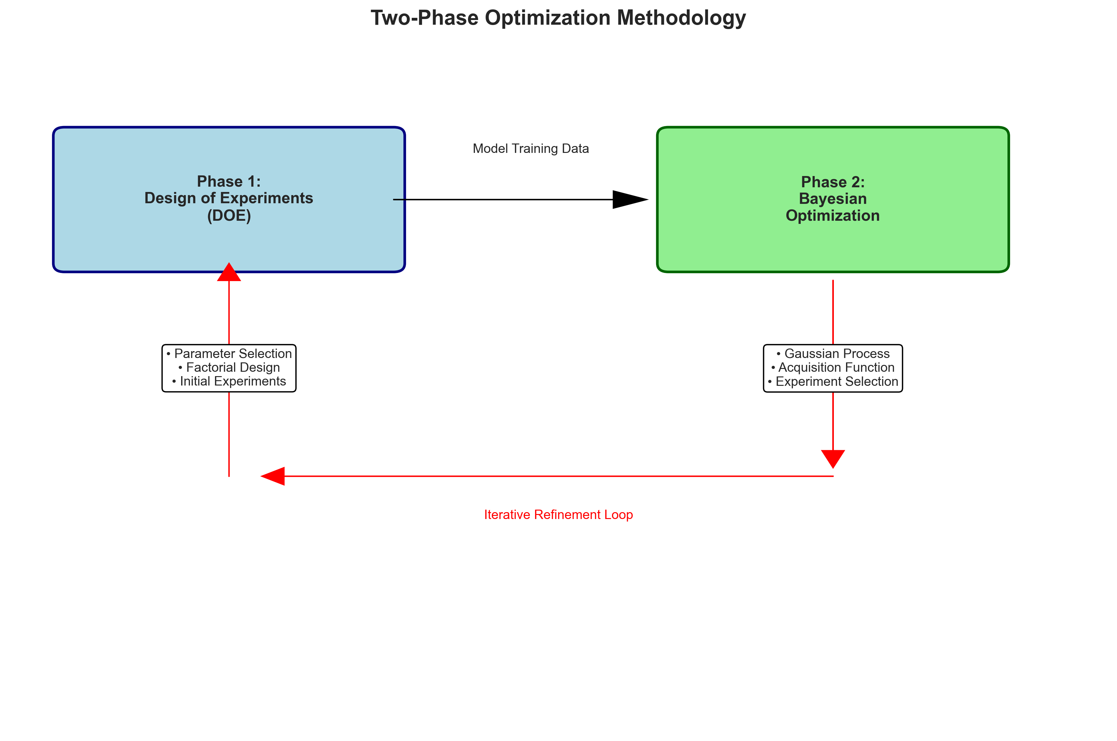
Process Flow Diagram
Usage: Visual representation of the DOE + Bayesian optimization workflow
Maps to: Slide 5: Concept and Methodology

Slide 3
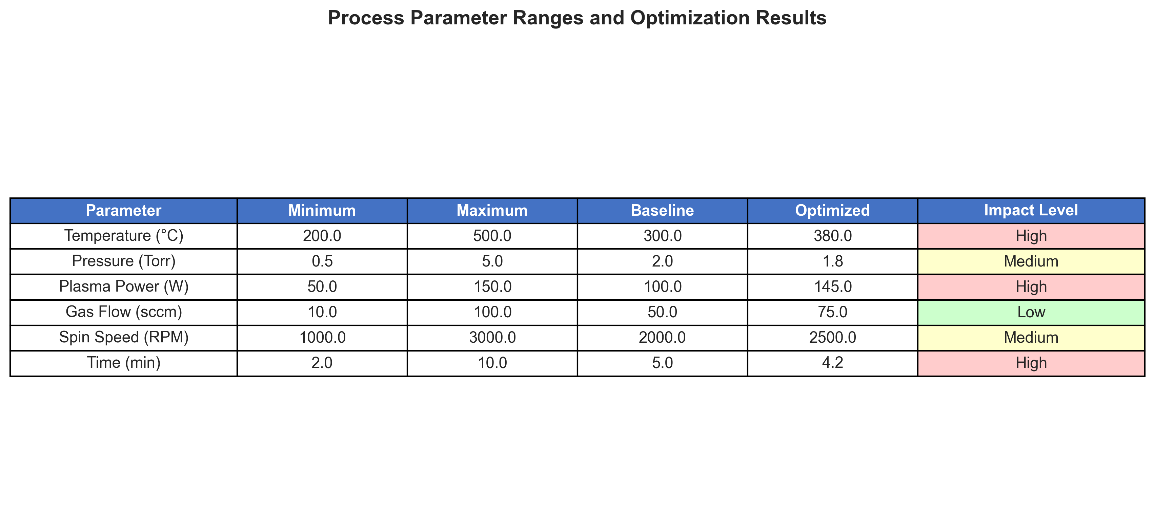
Parameter Ranges Table
Usage: Detailed parameter specifications and optimization outcomes
Maps to: Slide 7: Technical Implementation & Parameter Mapping

Slide 4
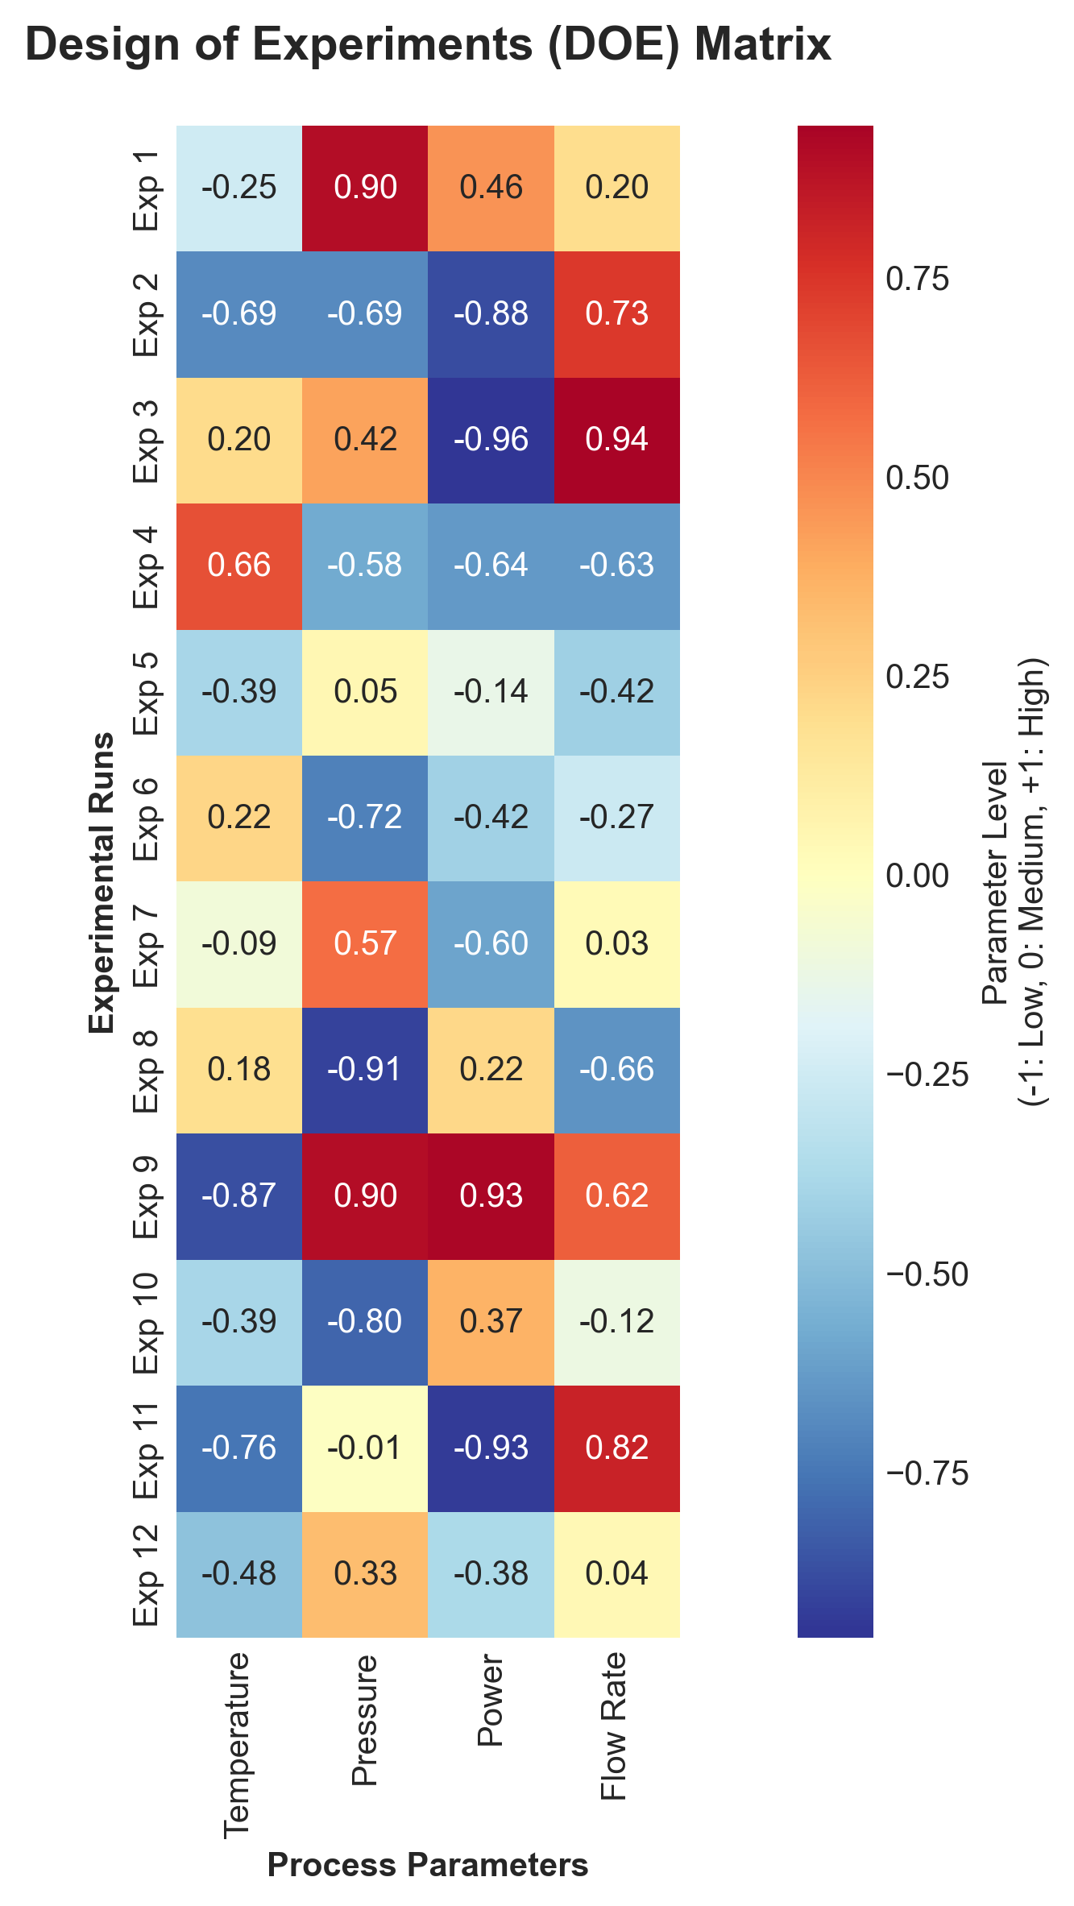
DOE Matrix Heatmap
Usage: Visual representation of experimental design structure
Maps to: Slide 6: Decision Framework (DOE & Design Tree)

Slide 5
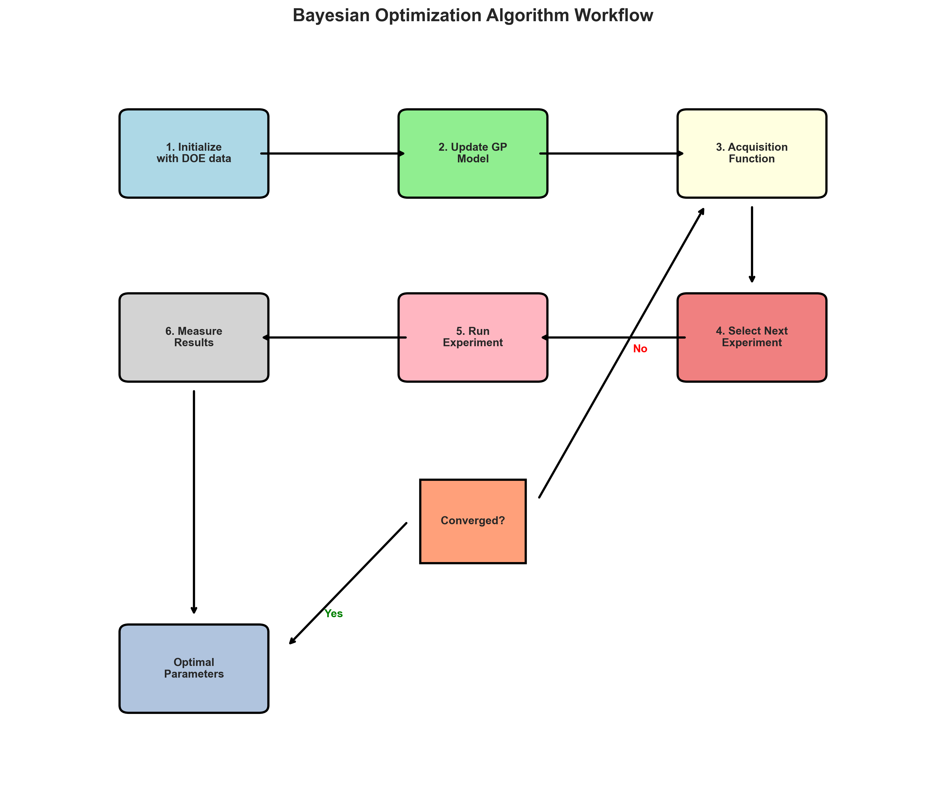
Bayesian Optimization Workflow
Usage: Step-by-step algorithm workflow with decision points
Maps to: Slide 8: Bayesian Optimization Code and Analysis

Slide 6
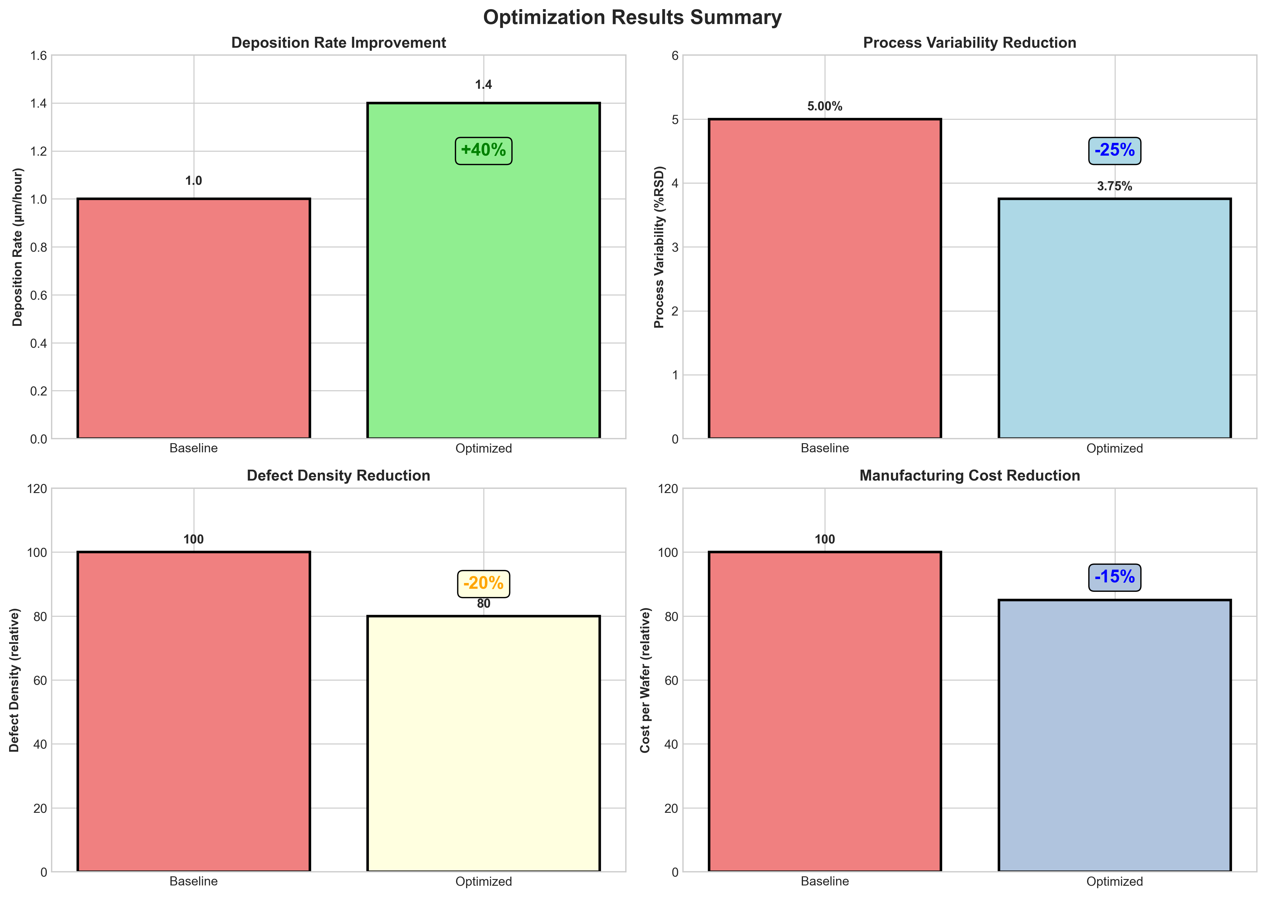
Results Summary Charts
Usage: Quantitative results showing 40% rate increase, 25% variability reduction
Maps to: Slide 9: Results & Data Interpretation

Slide 7
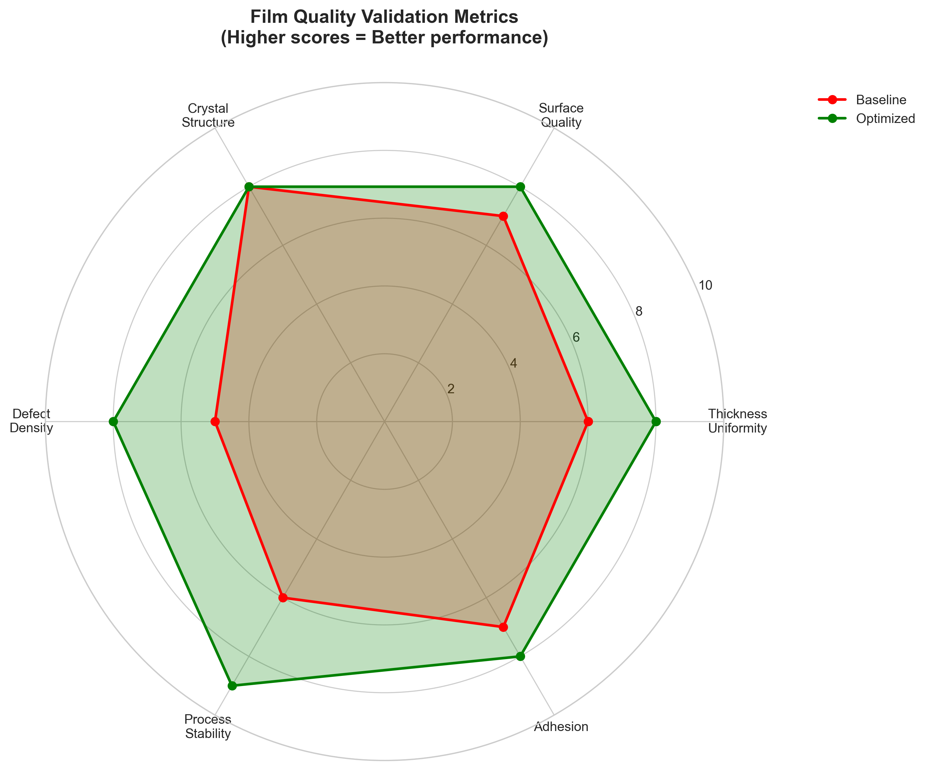
Validation Metrics Spider Chart
Usage: Multi-dimensional quality comparison baseline vs optimized
Maps to: Slide 10: Metrology & Validation

Slide 8
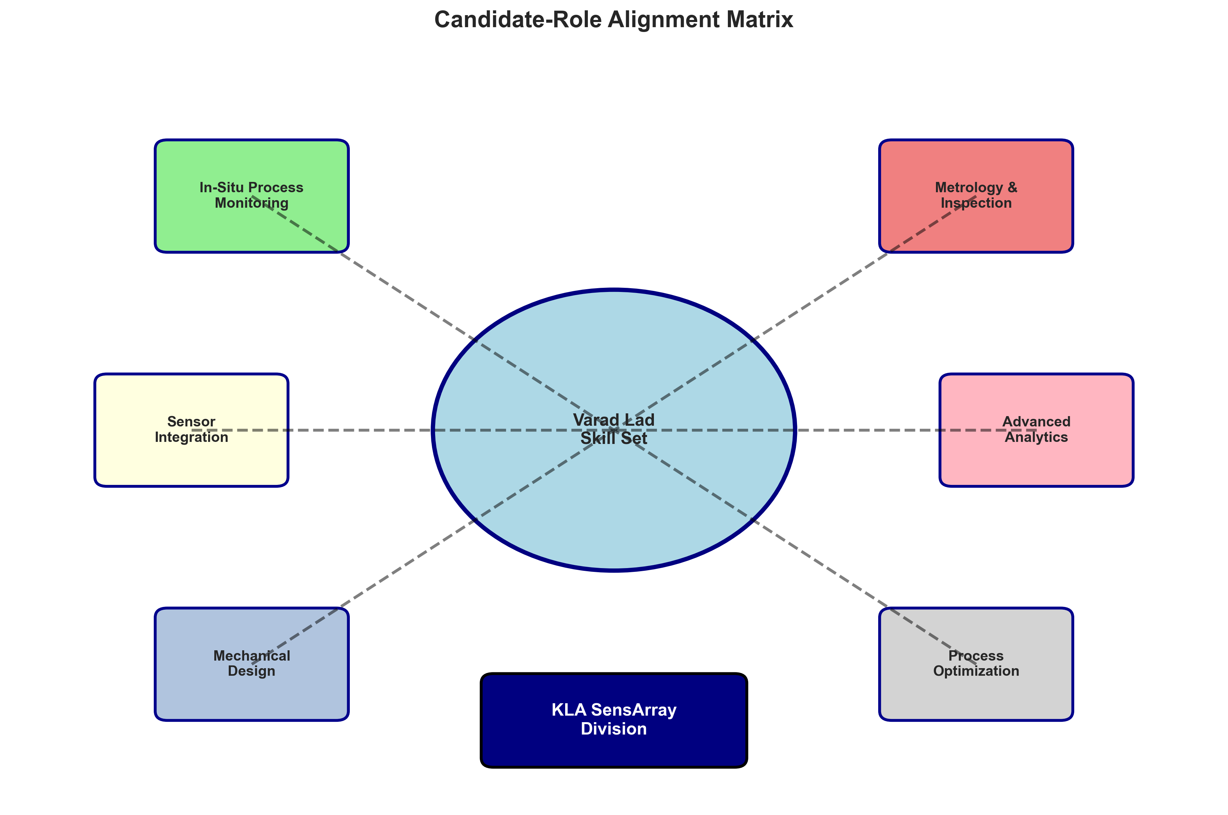
KLA Alignment Diagram
Usage: Visual mapping of skills to KLA SensArray requirements
Maps to: Slide 11: Relevance to KLA & Candidate Fit

Slide 9
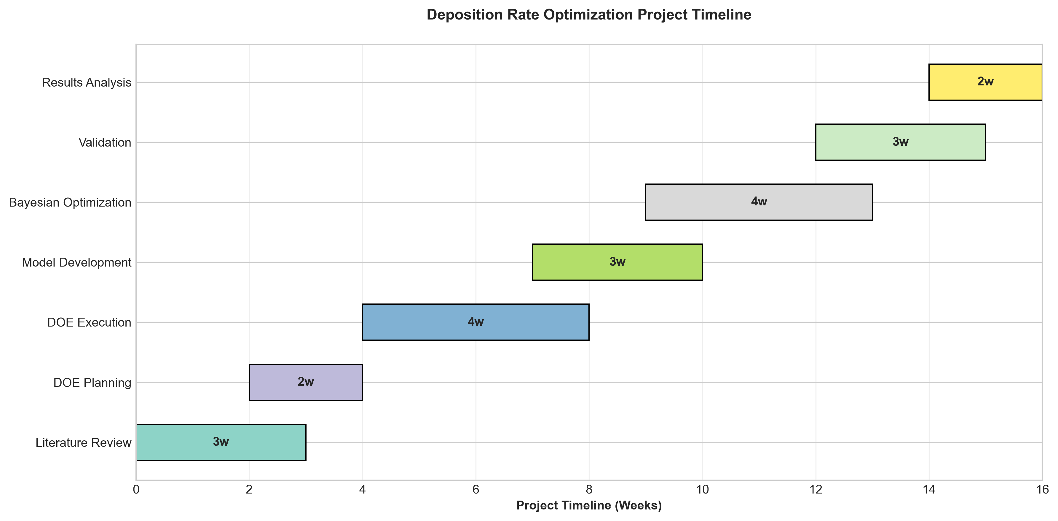
Project Timeline
Usage: Project management timeline showing systematic approach
Maps to: Additional/Backup slide

Slide 10
Visual Elements Mapping Guide
• Process Flow Diagram
→ Slide 5: Concept and Methodology
→ Visual representation of the DOE + Bayesian optimization workflow
• Parameter Ranges Table
→ Slide 7: Technical Implementation & Parameter Mapping
→ Detailed parameter specifications and optimization outcomes
• DOE Matrix Heatmap
→ Slide 6: Decision Framework (DOE & Design Tree)
→ Visual representation of experimental design structure
• Bayesian Optimization Workflow
→ Slide 8: Bayesian Optimization Code and Analysis
→ Step-by-step algorithm workflow with decision points
• Results Summary Charts
→ Slide 9: Results & Data Interpretation
→ Quantitative results showing 40% rate increase, 25% variability reduction
• Validation Metrics Spider Chart
→ Slide 10: Metrology & Validation
→ Multi-dimensional quality comparison baseline vs optimized
• KLA Alignment Diagram
→ Slide 11: Relevance to KLA & Candidate Fit
→ Visual mapping of skills to KLA SensArray requirements
• Project Timeline
→ Additional/Backup slide
→ Project management timeline showing systematic approach

